Slide 1
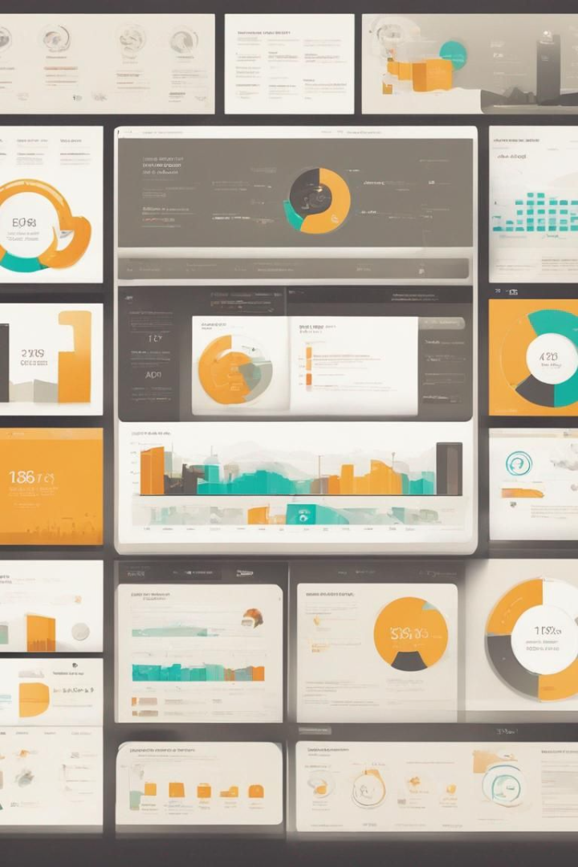
Conducted SQL-based analysis to identify and address selection gaps on Amazon
The examination of product performance metrics through SQL-based analysis to uncover insights. These insights enable the identification of selection gaps within product offerings, highlighting areas where customer demand may not be adequately met or where product performance falls short of expectations.
The dataset source is https://www.kaggle.com/datasets
By Bushra Fatima

Slide 2
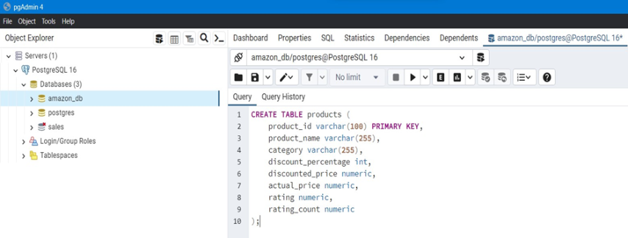
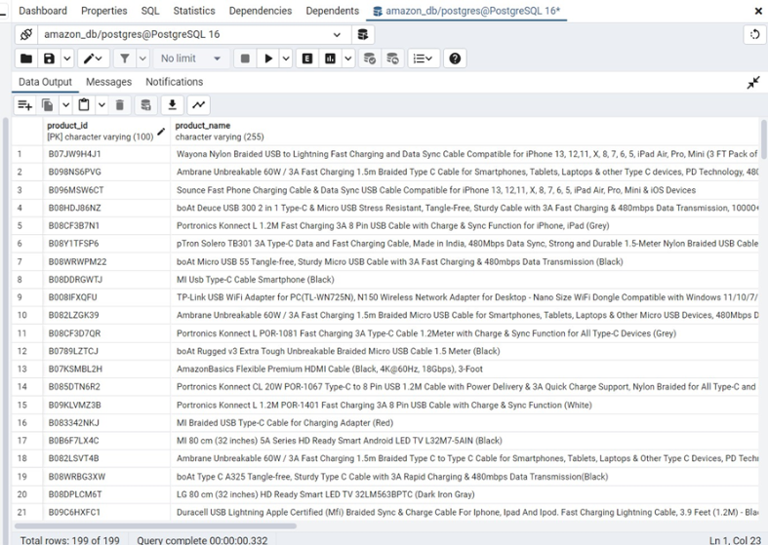
CREATING A TABLE products in database amazon_db using the query in postgre SQL
Result of the query after data is imported in database amazon_db

Slide 3
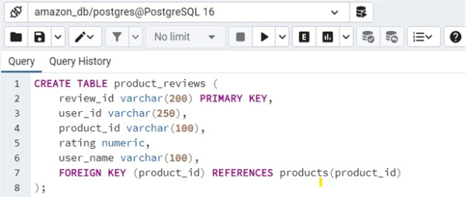
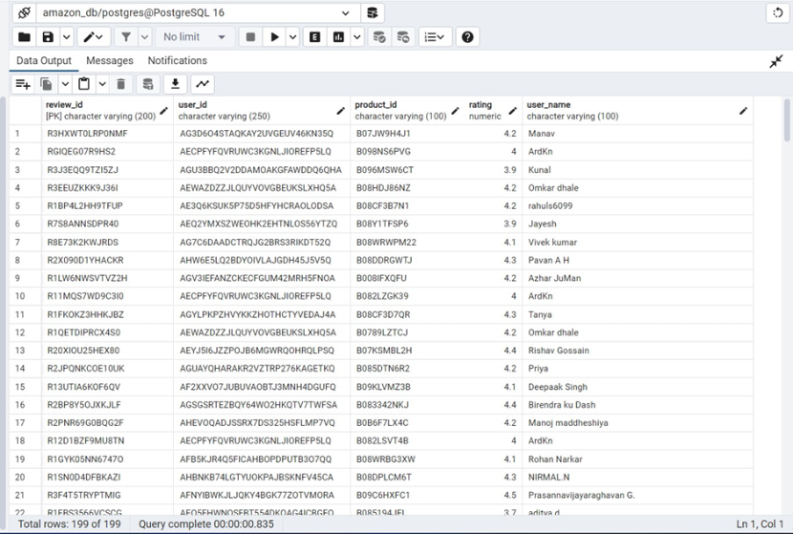
CREATING ANOTHER TABLE product_review in database amazon_db using the query
Results of query after the data is imported in table product_review

Slide 4
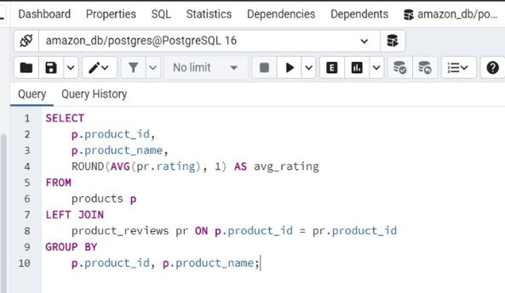
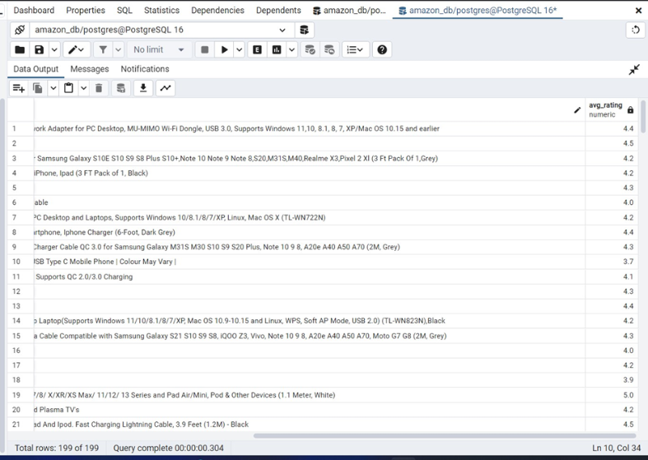
1. QUERY FOR AVERAGE RATING OF EACH PRODUCT
Results for average rating of each product
Loading...

Slide 5
Average Product Ratings
Insightful data on the average rating for each product.
4.5
3.2
2.0
Top Rated
Mid Range
Low Rated

Slide 6
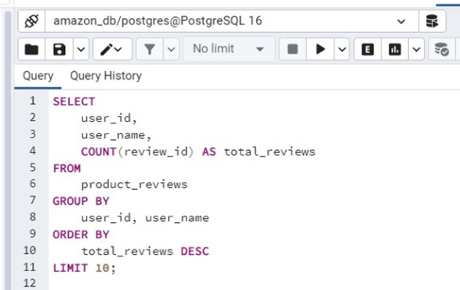
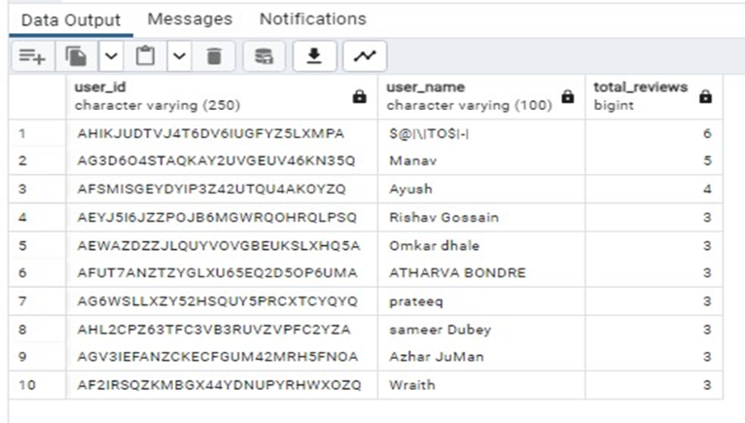
2 . TOP 10 USERS WHO HAVE PROVIDED THE MOST REVIEWS
RESULT OF 10 USERS WITH MOST REVIEWS

Slide 7
Top Reviewers
Highlighting the top 10 users contributing the most reviews.
1
Most Active
2
Engaged
3
Influential
Users leading in review counts.
Contributors shaping product insights.
Reviewers impacting customer decisions.

Slide 8
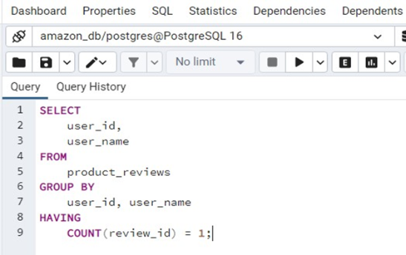
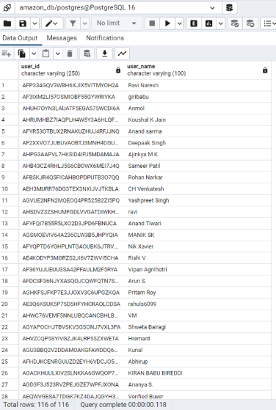
3.USERS WITH ONLY ONE REVIEW:
RESULTS OF USER WITH ONLY ONE USER

Slide 9
Insights from a Single User Review
As a business, a single user review can provide valuable insights into the satisfaction customers. Here are some key points to consider:
1
Product Strengths and Weaknesses
2
Customer Sentiment
Understand the emotions and attitudes of your customers towards your product.
Identify what customers appreciate and what needs improvement.
3
Opportunities for Improvement
feedback can be used to make improvements and optimize your product.

Slide 10
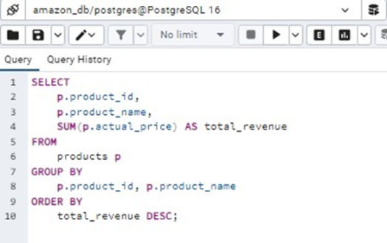
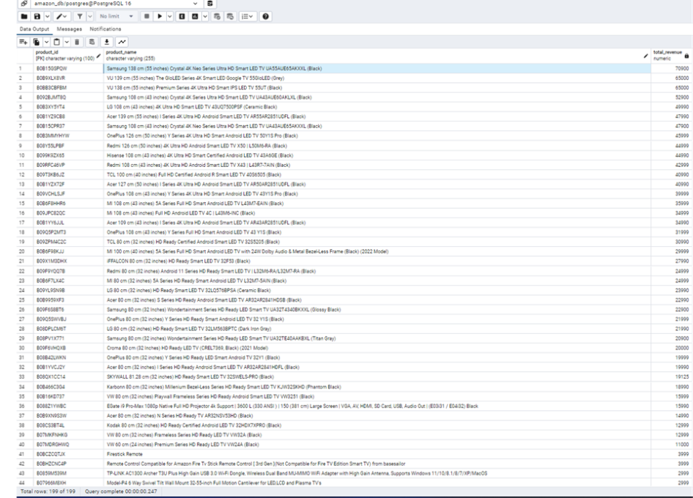
4. TOTAL REVENUE GENERATED BY EACH PRODUCT
Result for total revenue generated by each products

Slide 11
Revenue by Product
Analysis of highest total revenue generated by each product giving insights as below.
Product category A
Phone
Product category B
Electronic home Devices
Product category C
Laptop

Slide 12
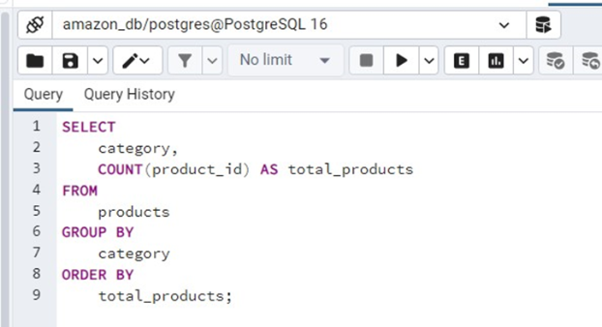
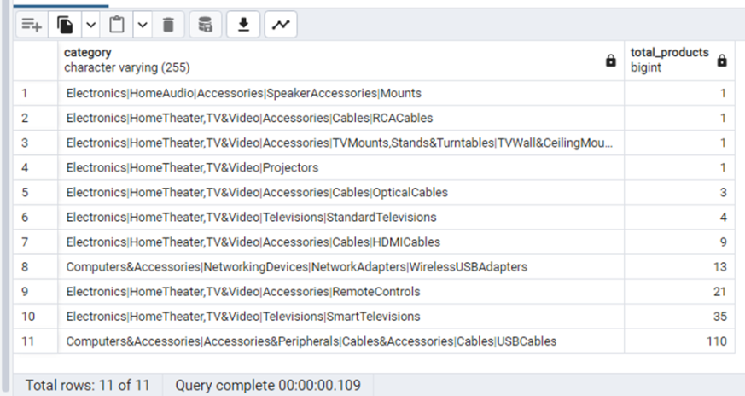
5. QUERY TO IDENTIFY CATEGORIES WITH FEWER PRODUCTS:
Results for categories with Fewer Products

Slide 13
Categories Needing Expansion-identifying selection gap
Identifying categories with a limited range of products
Small Variety
Growth Potential
Market Gaps
Categories with the fewest options.
Opportunities for category expansion.
Identifying unmet consumer needs.

Slide 14
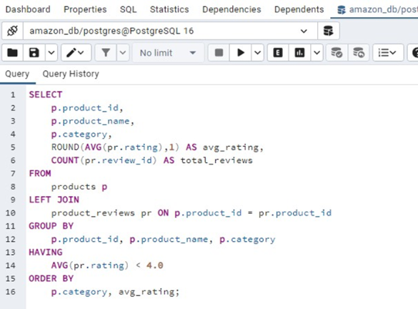
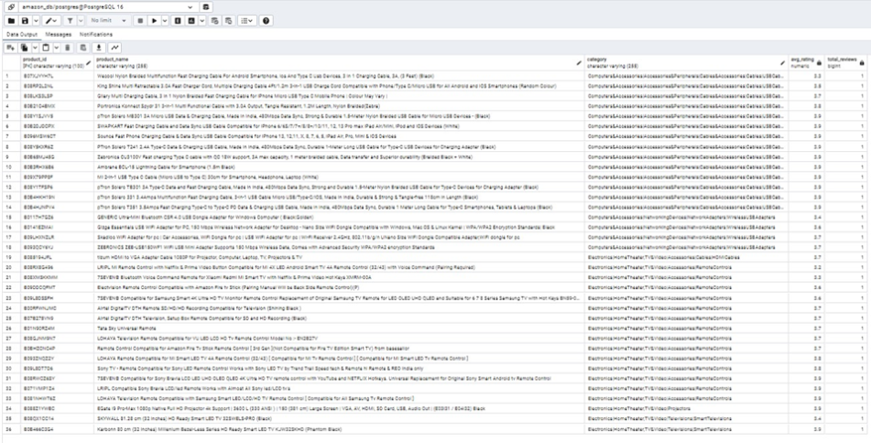
6. LOWEST RATED PRODUCT WITHIN EACH CATEGORY
Result for low rated products within each products

Slide 15


Lowest Rated Products
Insights into the lowest rated products within each category.
Category A
Electronics HomeTheate Remote Controls
Category B
Accessories Peripherals Cables& Accessories Cables USBCables

Slide 16
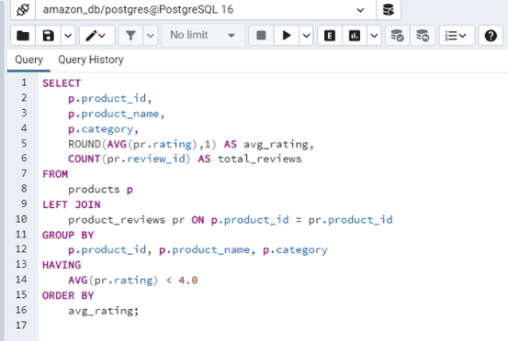
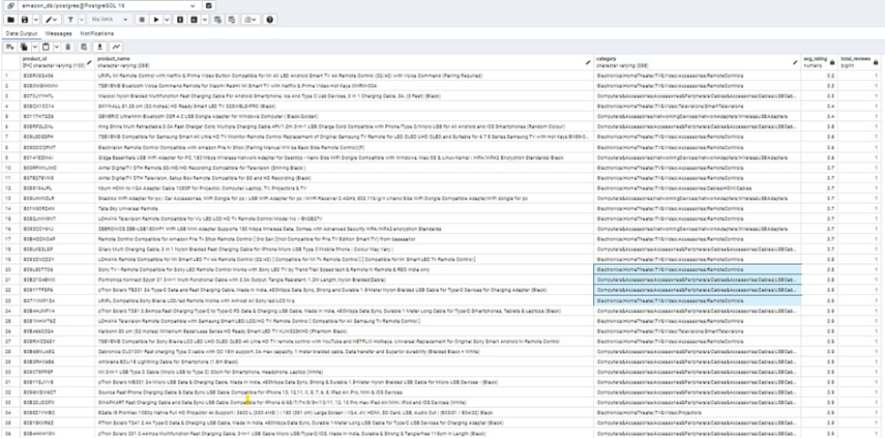
7. LOWEST RATED PRODUCTS OVERALL
Result for lowest rated products overall

Slide 17
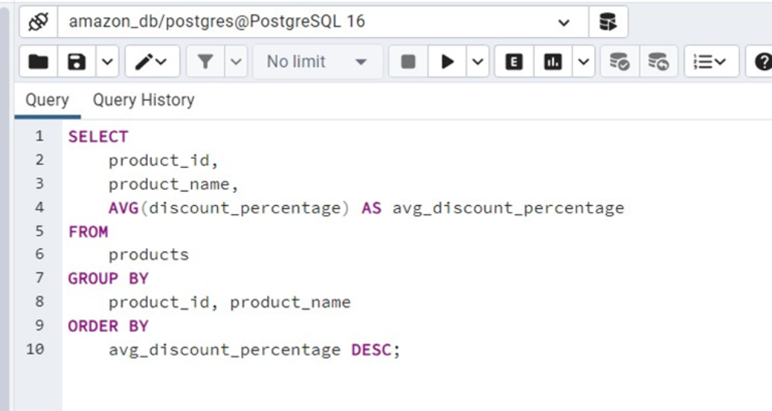
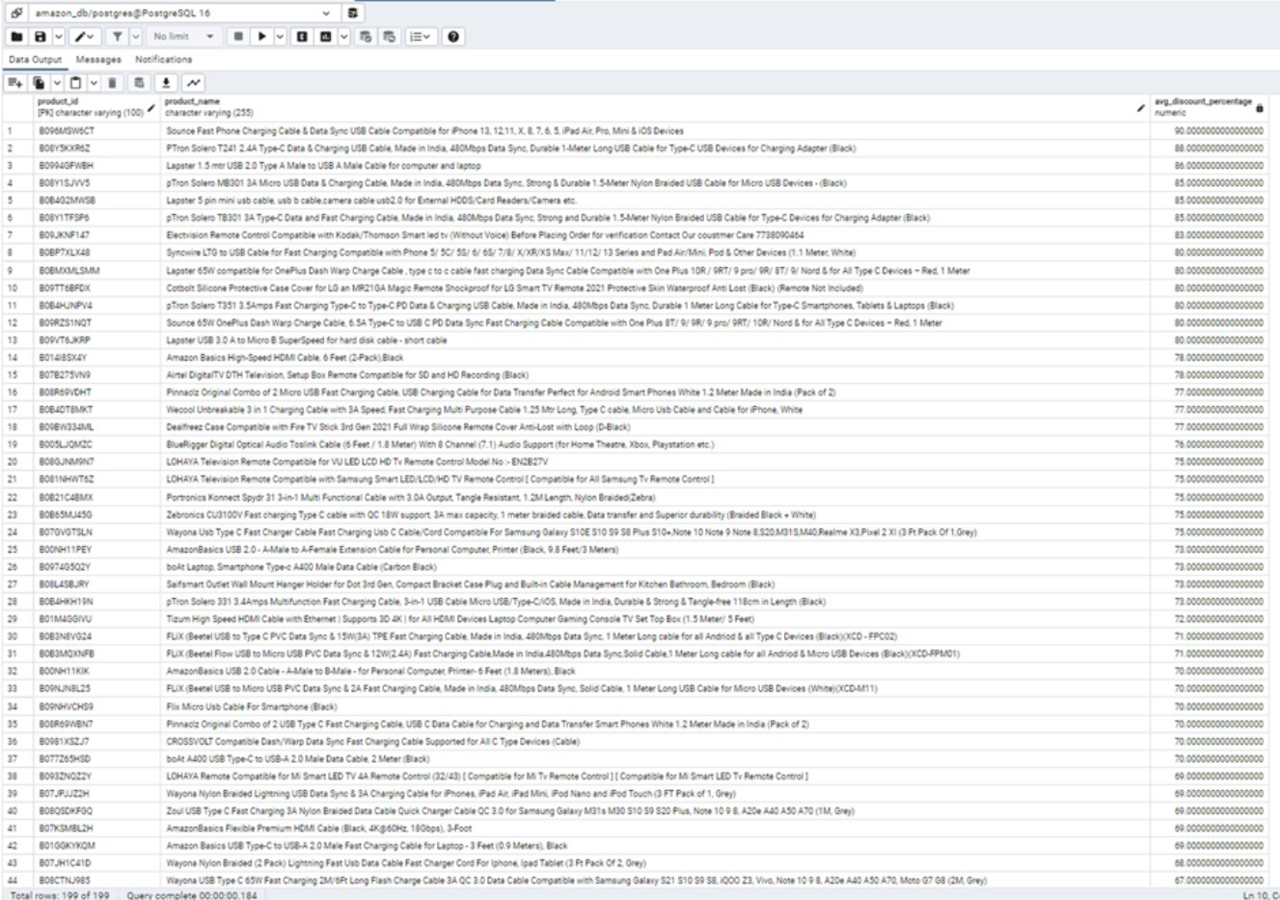
8. PRODUCTS WITH HIGHEST AVERAGE DISCOUNT PERCENTAGE
Result for products with highest average discount percentage

Slide 18
Highest average discounted product analysis further helps in
Demand analysis
Pricing strategy evaluation
Understanding Customer behaviour

Slide 19
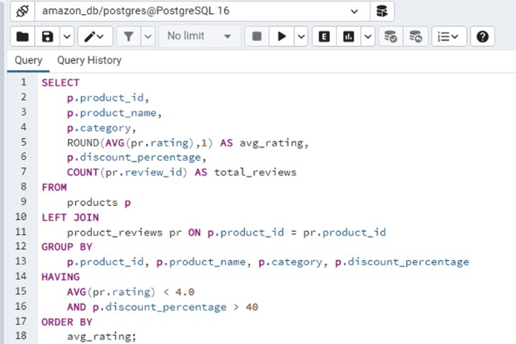
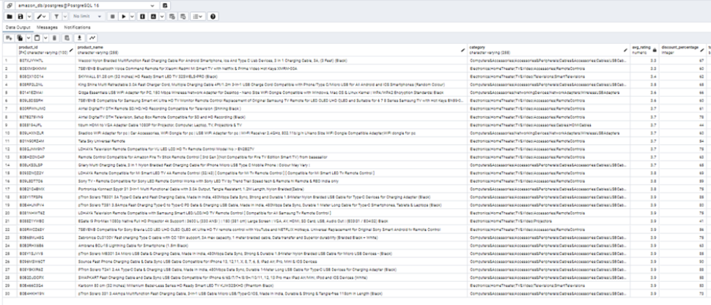
9. LOW-RATED PRODUCTS WITH HIGH DISCOUNT PERCENTAGE
Result for low rated products with high discount percentage

Slide 20
Discounts and Ratings
Correlation between high discounts and low-rated products can provide insights as
1
Inventory management analysis
2
Low Ratings & High Discounts
Low-rated products with high discount percentage need attention For product Performance analysis

Slide 21
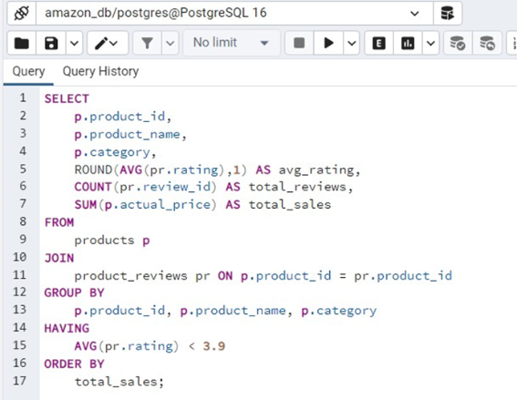
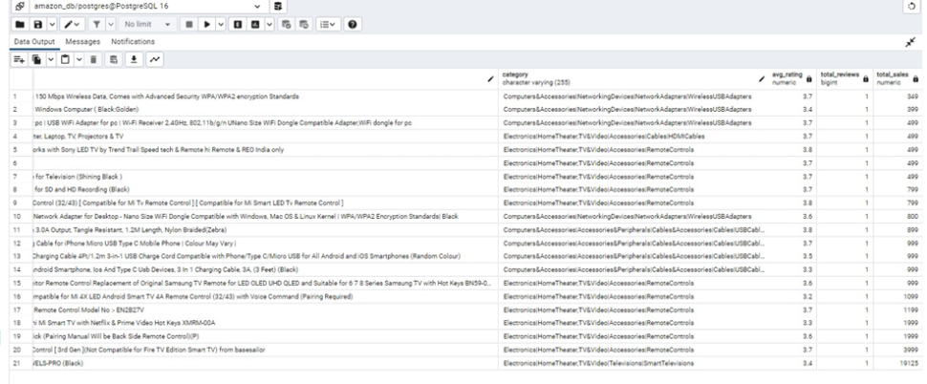
10. LOW-RATED PRODUCTS WITH LOW SALES VOLUME
Result for low-rated products with low sales volume

Slide 22

Low rated products and Low Sales Volume
REQUIRES ATTENTION TOWARDS filling product performance gap AND improvements.

